Slide 1
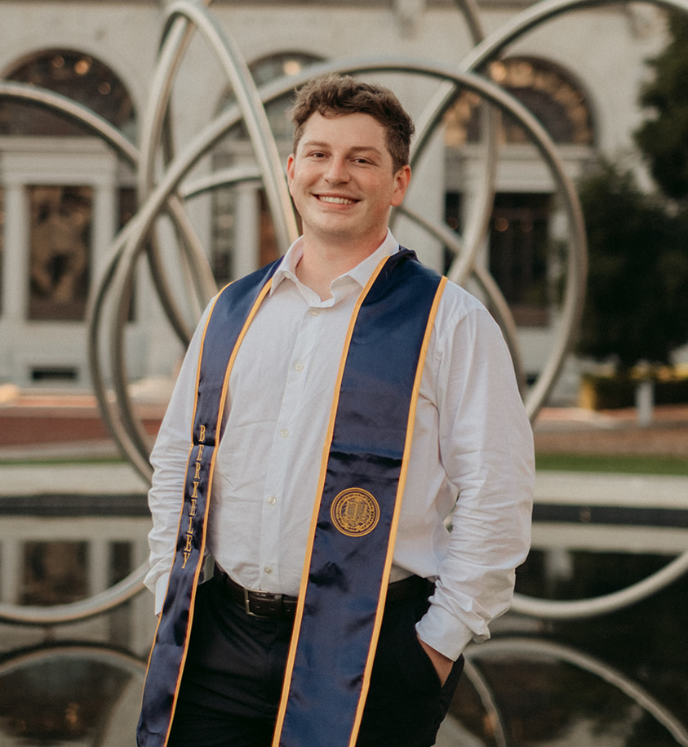
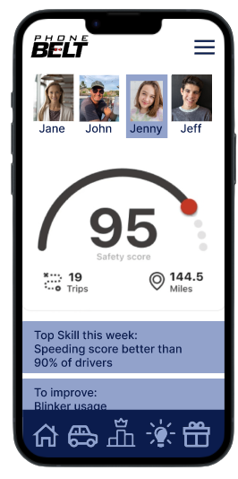
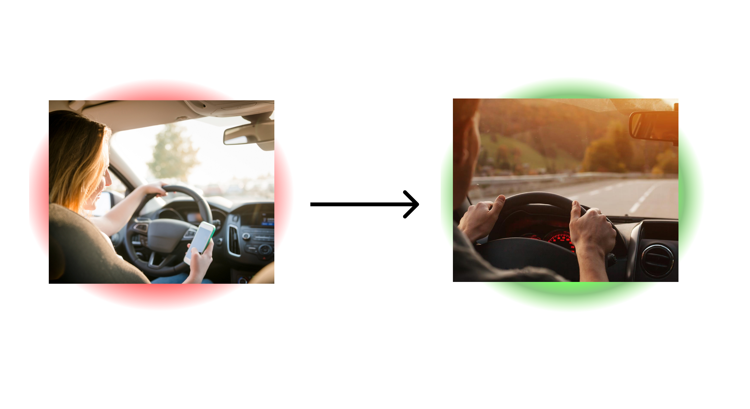
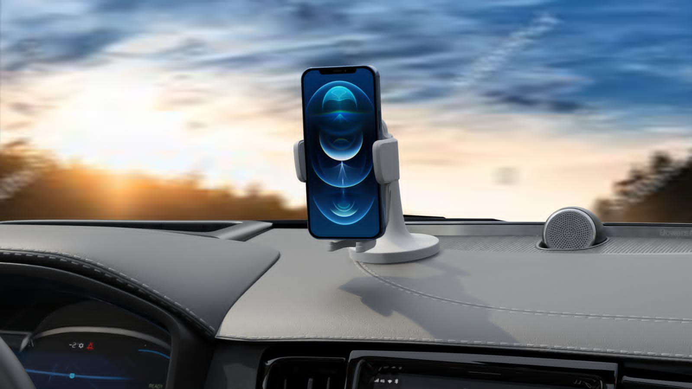




Team Name: PhoneBelt
Date: 08/14/23
Business Thesis:
We provide driver monitoring and insights for parents of new drivers
James Coleman
 | Interview count
Since last meeting | 14 | 6 |  | 5
Total | 23 | 17 | 6

Slide 2
Hypothesis tested:
Car insurance is a significant customer “pain”
Parent’s care about being in control of data versus insurers having it
Questions we asked to test the hypothesis:
Tell me about the last time you switched your car insurance
Have you ever used an insurers app or beacon? Why or why not? Tell me about it
Do you track your teen’s driving today? Why? How?
Who in your family is the most difficult to insure. What was that process like?
How did your teen learn to drive? Tell me about that story.
Who we interviewed:
Duane Morningred
Kathy Morningred
Jeff Bilgen
Eric Gonzales
Julie Cleary
Sara Rummell

Slide 3
What we heard:
Getting car insurance is a pain in the ass ; insurance is full of big claims that often do not actually pan out
Data privacy is a concern
Many people do not trust insurers with their driving data. They do not have their best interests at heart. They have not incentive to make less money by passing out discounts. Discounts not big. Insurers will sometimes charge more.
What we learned:
Insurance is a major customer pain where the teen tracking was a “gain”
no trust for car insurers
Data privacy is important

Slide 4
Next steps:
Find what triggers would genuinely inspire someone to download an app.
Doing competitor research
See how parents respond to app form factor, IOT form factor, or both
Still talk to people outside of customer segment to understand broader market especially insurance and fleet owners

Slide 5




Business Model Canvas
Designed for: CREA
Designed by: James Coleman
Date: 08/07/23
Version: 3
Key Partners Driving schools Gov agencies that promote safe driving or involved with driving at all (DMV) Distracted driving related charities, foundations and non-profits School districts hosting distracted driving awareness week/ red ribbon week & districts that allow students to purchase on-site parking passes Community safe driving advocates. Government officials Occupational safety organizations/ government arms Parenting social media platforms and their moderators Existing indirect competitors or companies in this space that are willing to collaborate in mutually beneficial ways Who will help you? | Key Activities Build product Talk to customers Find and apply to grants Add cofounders/ employees How do you doit? | Value Propositions We provide parents the feelings of child protection while they are not physically with their teen Reduce the time parents spend time calling to check on their teen Allow parent to allocate their time and parenting to their teens that need additional help behind the wheel The peace of mind knowing their child has the tools to improve their safety behind the wheel We provide parents relief by allowing them to visualize their teen’s improvement What do you do? |  | Customer Relationships Hands off onboarding at scale Continual support through the app and the ability to talk to a rep Incentives to share the app with their friends and social media How do you interact? | Customer Segments Parents of teenage drivers, especially those using existing solutions like Life360 Who do you help?
 | Key Resources App developers Cash for building team Insurtech conference/ accelerators/ connections (industry and legal knowledge) Contract Manufacturer for hardware What do you need? |  |  | Channels Earned media (novel and controversial product) Social media marketing (working with bloggers, vloggers, reviewers, as well as our own content) Kickstarter Driving sales/ attention with driving schools and other partners Ad campaign aimed at life360 users Friend Referrals How do you reach them?
Cost Structure Hardware Costs COGS (landed) - $15 SG&A – $10 Certification costs (12k) App costs Cloud computing and storage costs (Storage, Inbound, Outbound, Compute per gig TBD) What will it cost? |  |  | Revenue Streams Freemium subscription model {free, silver, gold} Ex: $10 MRR per customer How much will you make?
Notes:
HANDOUT 1: BMC

